Slide 1
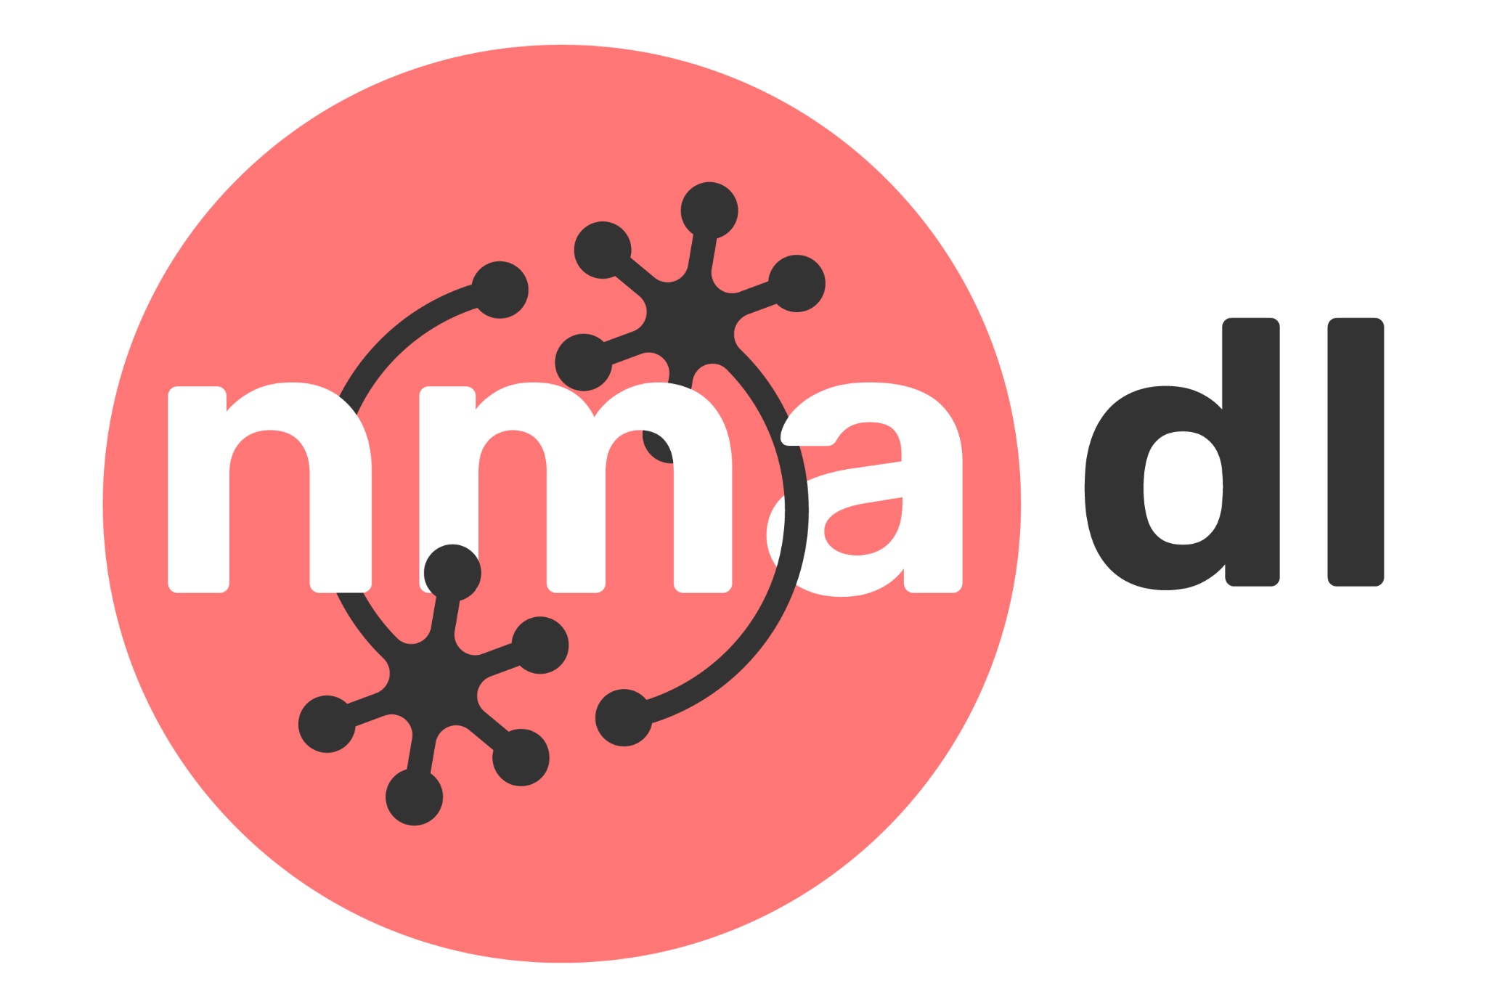
Cell Segmentation Using U-Net Architecture
By: Taha A. P, Shania H, Shahanas V, Shaharin V, Rawaa Rajab
Group Name: NMA_SEG
Pod: Splendid Meconopsis

Slide 2
Why is breast cell segmentation important?
Abstract
Breast cell segmentation is particularly important due to its significant implications in breast cancer diagnosis, treatment, and research.
Our study is to investigate the effectiveness of the U-Net architecture for the segmentation of breast cancer cells using the BUID dataset.
How effectively can the U-Net architecture segment breast cancer cells in the BUID dataset?

Slide 3
Application of Image Segmentation
Medical Imaging:
  Disease Diagnosis : Segmentation helps to identify and measure tumors, organs using MRI and CT.
  Surgical Planning : Precise Segmentation aids surgeons in planning and performing operations .
Agriculture:
  Crop Monitoring : Segmenting images can help to monitor crop health,identify weeds, and estimating yields.
  Precision Farming : Enables targeted actions like spraying pesticides or watering specific areas.
Autonomous Vehicles:
  Object Detection and Recognition: Segmentation is crucial for identifying and classifying objects.
  Scene Understanding : Helps in understanding the driving environment and making safe navigation.
Industrial Automation:
  Quality Control : Automated inspection of products on production lines to identify defects.
Remote sensing:
  Land Use and Land cover : Segmentation is used to classify different land types ( forests, water bodies, urban areas)

Slide 4
Dataset
The BUID dataset consists of breast ultrasound images collected in 2018 from 600 female patients aged 25 to 75. [1]
It includes 780 images in PNG format, each with an average size of 500 x 500 pixels.
The images are categorized into three classes: normal, benign, and malignant, with ground truth masks provided alongside the original images.

Slide 5
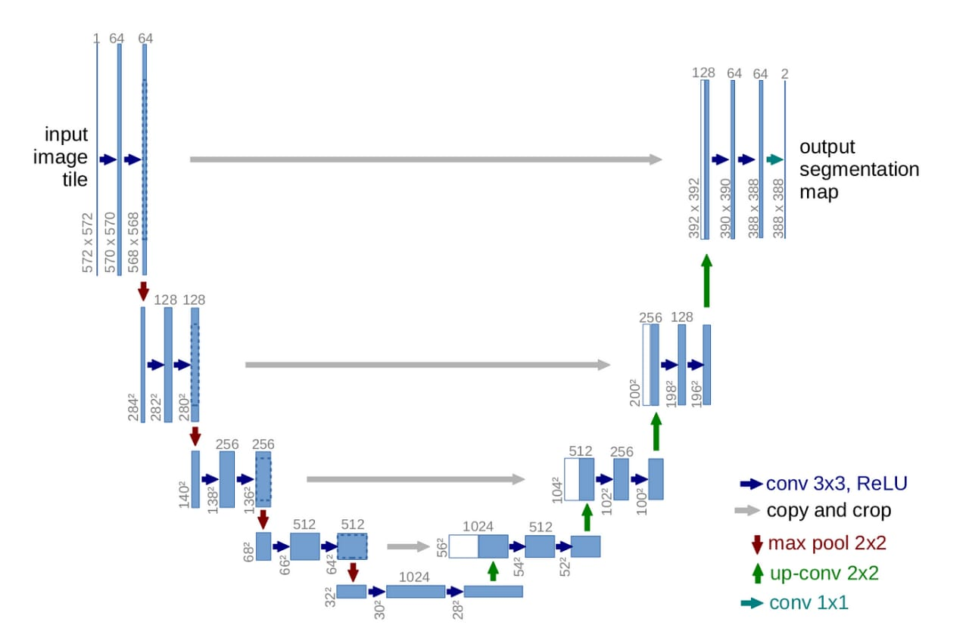
U-Net Architecture
A U-shaped neural networks for biomedical image segmentation which consist of encoder and decoder path,along with skip connections, that work together to extract and localize features in images.

Slide 6
Workflow
Loading the BUID dataset
Preprocessing the input image
Implementing the U-Net for image segmentation
Training the validation

Slide 7
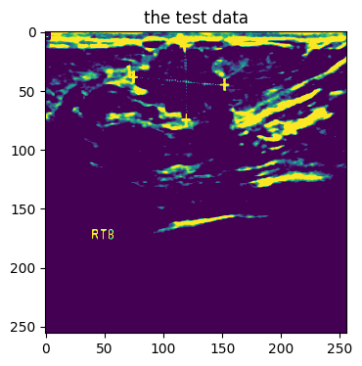
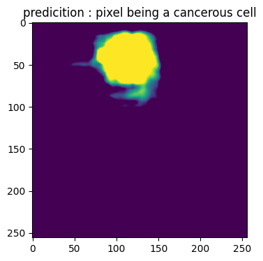
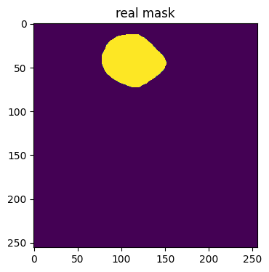
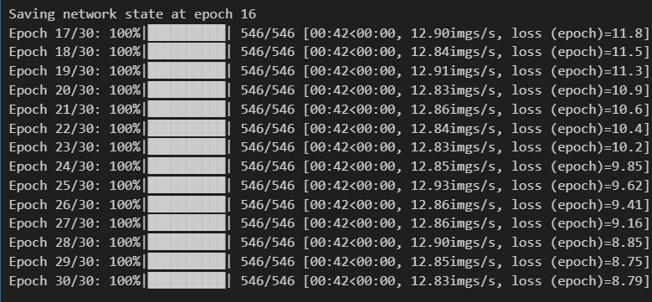
Result
Too many epochs => Overfit ? increased weight decay, tested on validation set
Exploding gradients ? decreased learn rate

Slide 8
Challenges/ Limitation
In order to obtain data as a torch dataset object, we had to write a class of dataset from scratch to be able to get an image and it’s mask with the index some images had more than one mask.
The breast cancer cell might look like a black hole or it can disguise amongst other cells !

Slide 9
THANK YOU!
Hearty thanks to our project TA Akinyemi Joseph and pod TA Charles Yusuf for their wonderful guidance to us!

